Slide 1

Build an AWS ETL Data Pipeline in Python on YouTube Data Analytics
Project Team: 13
Kata Puja (Y00858506)
Gurrapu Sanjay (Y00858505)
Suroju Sai Kishore (Y00855670)
Project Coach:
Dr. Feng George Yu
This Photo by Unknown Author is licensed under CC BY

Slide 2
Introduction
Today, we embark on an exciting journey into the world of data engineering, where we will explore the process of building an Extract, Transform, Load (ETL) Data Pipeline using the robust combination of Amazon Web Services (AWS) and Python. Our focus? The vast and dynamic landscape of YouTube data.
ETL is a critical component of the data processing lifecycle, facilitating the integration, transformation, and storage of data for effective analysis and decision-making. It plays a foundational role in ensuring that organizations can harness the full potential of their data assets.
Building an AWS ETL pipeline for YouTube data using Python involves several steps, from data extraction to transformation and loading into AWS services. Here's a high-level overview of the process:
Data Extraction from YouTube
Setting Up AWS S3 for Storage
Data Transformation with AWS Glue
Automation with AWS Step Functions or Lambda
Data Visualization Using AWS QuickSight

Slide 3
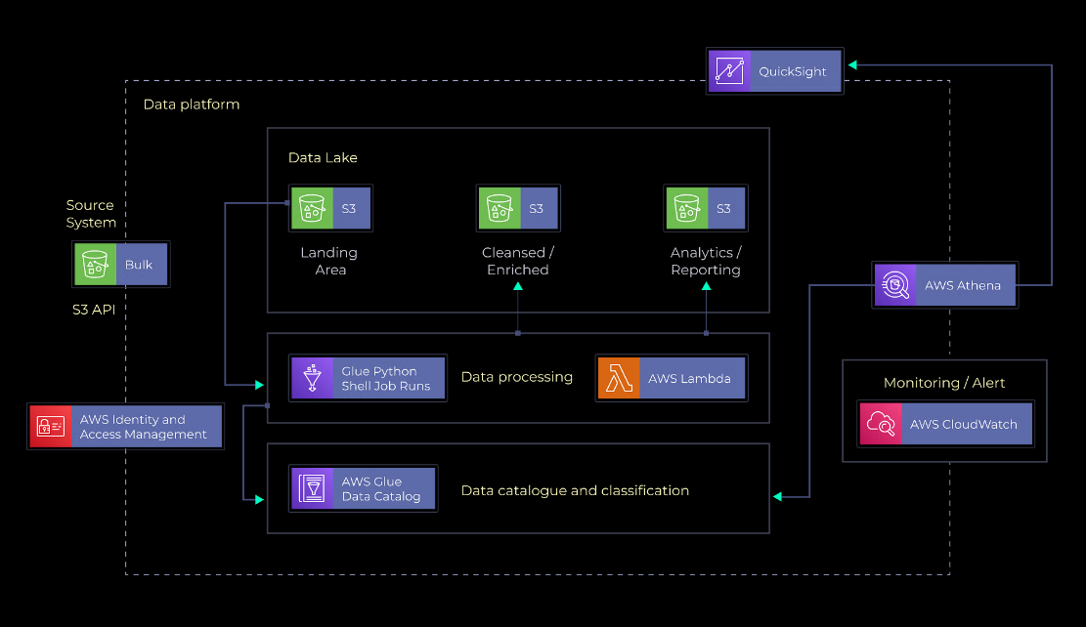
Background

Slide 4
Problem Statement
AWS ETL Pipeline Using Python- Business Overview
Over 2.6 billion individuals worldwide use YouTube monthly, making it one of the top-most visited websites. Now, imagine your company will launch a new data-driven campaign, and you are in charge of the campaign advertisements. Which platform do you think will be ideal for the advertisement? None other than YouTube! This means the company will have to analyze large volumes of YouTube data using various tools and metrics to effectively understand how to advertise its new campaign on the platform. The company might want to find answers to questions such as ‘how to categorize videos based on the number of comments and statistics’, ‘what factors affect how popular a YouTube video will be’, etc.

Slide 5
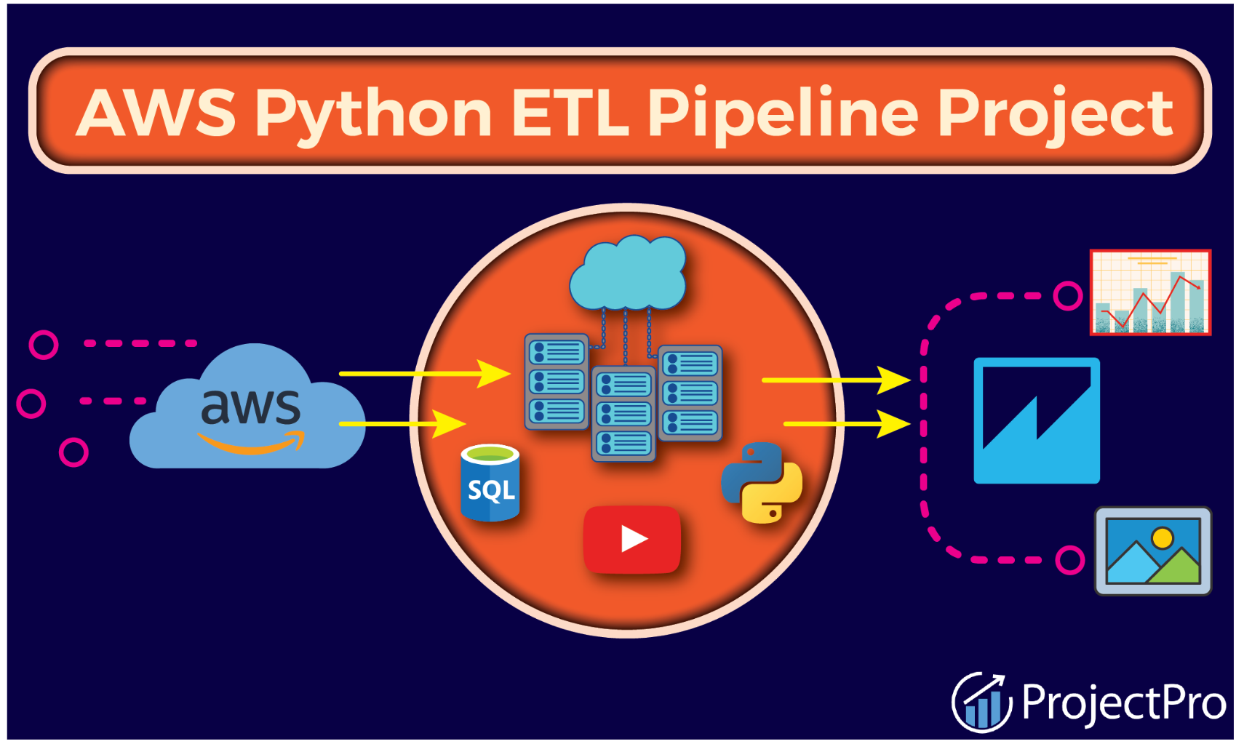
This project aims to securely manage data, streamline, and analyze the structured and semi-structured YouTube video data based on the video categories and trending metrics.
Aim Of The AWS Python ETL Pipeline Project
This big data project aims to build an ETL Pipeline using Python and various AWS tools and services, including Athena, Lambda, and Glue, on a YouTube video dataset from Kaggle.
AWS ETL Pipeline Using Python Project- Dataset
This Python ETL pipeline big data analytics project uses the YouTube dataset from Kaggle that contains statistics (CSV and JSON files) on popular daily YouTube videos over many months.
AWS Python ETL Data Pipeline Project- Tech Stack
➔ Languages- SQL, Python3
➔ Services- AWS S3, AWS Glue, QuickSight, AWS Lambda, AWS Athena, AWS IAM

Slide 6
Key Concepts In AWS ETL Pipeline Python Project
(Methodology)
Data Pipeline
A data pipeline is similar to a conveyor belt for transferring raw data from one system to another. Depending on the situation, it can handle data from various sources in real-time or in batches. The pipeline includes everything from collecting and storing data to data analytics and transforming it into a format ready to be queried. It shows key performance indicators (KPIs) and manages the ETL process.
Amazon S3
Amazon S3 (AWS Simple Storage Service) is a highly scalable object storage service offered by AWS, which provides secure and durable storage for various data types, such as documents, images, videos, etc. With S3, you can easily store and retrieve data anywhere online. It offers high availability, scalability, and cost-effective storage options.
AWS IAM
AWS Identity and Access Management (IAM), a popular service by Amazon Web Services (AWS), enables users to manage access and permissions to their AWS resources securely. Using IAM, users can create and manage user accounts, assign granular permissions, and control who can access your AWS services and resources. IAM allows you to set up policies to define fine-grained access controls, ensuring that only authorized users or services can interact with your AWS environment. It's a crucial tool for maintaining security and ensuring compliance within your AWS infrastructure.

Slide 7
AWS QuickSight
Amazon QuickSight is a scalable, serverless, embeddable, machine learning-powered business intelligence (BI) service built for the cloud. It is the first BI service to offer pay-per-session pricing, where you only pay when your users access their dashboards or reports, making it cost-effective for large-scale deployments. It can connect to your data from various sources like Redshift, S3, Dynamo, RDS, files like JSON, text, CSV, TSV, Jira, Salesforce, and on-premises Oracle SQL-server.
AWS Glue
AWS Glue is a serverless data integration service that makes it easy to collect, process/repare, and combine data for data analytics, machine learning, and application development. It runs Spark/Python code without managing Infrastructure at a nominal cost. You pay only during the run time of the job. Also, you pay storage costs for Data Catalog objects. Tables may be added to the AWS Glue Data Catalog using a crawler. The majority of AWS Glue users employ this strategy. A crawler can crawl multiple data sources and repositories in a single run. The crawler adds or modifies one or more tables in your Data Catalog after it's finished.

Slide 8
AWS Lambda
Lambda is a computing service that allows data engineers and programmers to run code without creating or managing servers. Lambda executes the code on high-availability computing infrastructure and manages all aspects, including server and operating system maintenance, capacity provisioning and automated scaling, code monitoring, and logging. Lambda allows you to run code for almost any application or backend service.
AWS Athena
AWS Athena is a serverless query service offered by AWS that allows you to analyze data stored in Amazon S3 using standard SQL queries without needing to manage infrastructure. With Athena, you can quickly extract insights from your data by querying both structured data and unstructured data formats. It offers on-demand scalability and cost-effectiveness, making it an efficient tool for ad-hoc data analysis and exploration.

Slide 9
AWS Python ETL Pipeline Project- Dataset Understanding
This ETL Pipeline using Python project uses the Kaggle YouTube video dataset, which includes up to 200 trending videos published daily for many locations. The data for each region is in its file. The video title, channel title, publication time, tags, views, likes and dislikes, description, and comment_count are among the items included in the data. A category_id field, which differs by area/region, is also included in the JSON file linked to the region.
Setting Up The Environment For Building A Python Data Pipeline
In this ETL pipeline project, you must first create an AWS S3 account and log into it. Then create an IAM user/admin, set all necessary permissions, assign the MFA device, etc. Next, you will install the AWS CLI (Command Line Interface) and enter the user credentials created earlier. You will then download and load data from the Kaggle YouTube video dataset before creating an AWS S3 bucket.

Slide 10
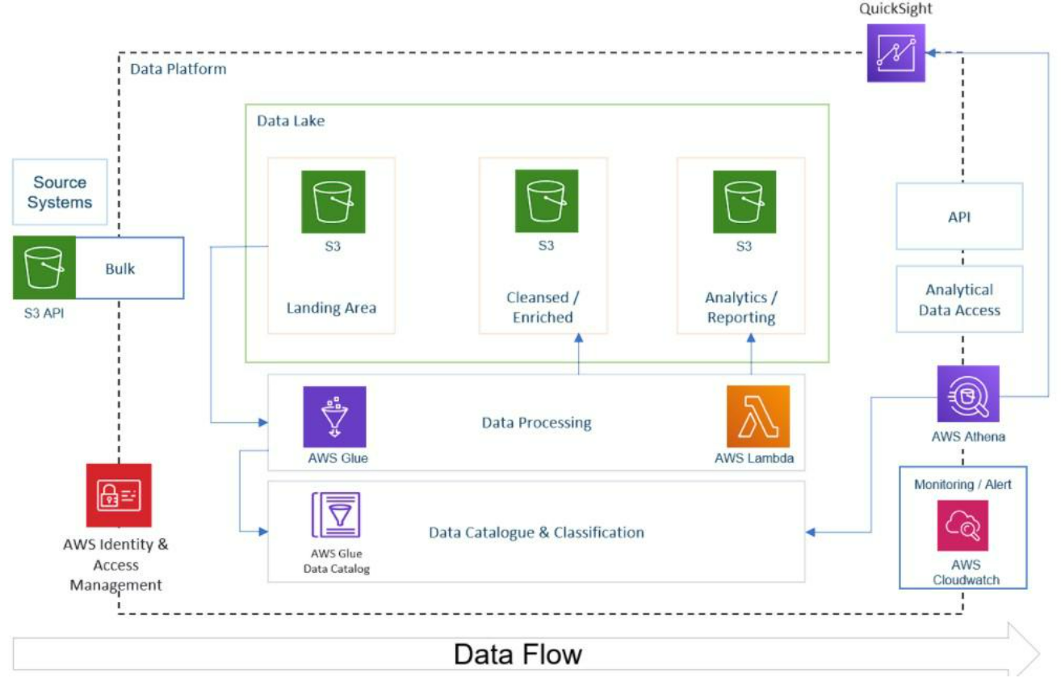
Creating An AWS S3 Bucket For The ETL Pipeline
The next step in this Python ETL project is to create an AWS S3 bucket following the best practices mentioned in the official AWS documentation and copy the data into the S3 bucket using the AWS CLI (Command Line Interface). Once you have successfully created the bucket, it’s time to copy all the data (CSV files containing YouTube video statistics for different regions) into the bucket. Then you will create an AWS Glue Catalog that will act as a central data repository.

Slide 11
Creating AWS Glue Catalog For The AWS ETL Pipeline
In this step of the project, you will learn the process of utilizing the AWS Glue service for data management and ETL (Extract, Transform, Load) tasks. The steps involve creating an AWS Glue Catalog, importing data from an S3 bucket using a crawler, and performing ETL using the AWS Glue ETL tool and SQL queries with Athena. Creating an AWS Glue crawler, specifying details like input source and output database further enhances the understanding of data extraction and organization.
You will also use AWS Glue to automatically discover and catalog data stored in your S3 bucket, enabling easier data querying and analysis. You will transform semi-structured JSON data into a more organized format suitable for SQL queries using Athena's SerDe libraries. The following step will give you hands-on experience implementing an ETL process to cleanse and convert the JSON data, preparing it for further analysis and exploration using SQL queries in Athena.

Slide 12
AWS Lambda Data Pipeline
This ETL (Extract, Transform, and Load) process mainly involves using an AWS Lambda function to extract the JSON data from the raw S3 bucket, convert it into Parquet format, push that data using AWS Data Wrangler into the clean S3 bucket, and automatically catalog it into the Glue Catalog, where you can query it using Athena SQL statements.
You will start by importing essential libraries like data wrangler and Python libraries like Pandas for efficient data manipulation in your ETL process. This step will allow you to understand how to write a Lambda function with event and context parameters. You must also create a data frame in memory and leverage Pandas to read data from the JSON file into the data frame, enabling data manipulation and transformation.
You will use a data wrangler to write the data frame to Parquet in S3 while simultaneously interacting with the Glue Catalog for efficient data cataloging and management. This step also involves creating a new S3 bucket for storing clean and optimized data obtained from the Lambda function, ensuring efficient data organization.
Next, it's time to create a new Lambda function that interacts with the S3 bucket and Data Catalog using Data Wrangler, allowing data extraction and manipulation. You must configure a test event (s3-json-youtube-put) to simulate and verify the Lambda function's behavior when triggered by an S3 event. You might also enhance the functionality of your Lambda function by adding Lambda layers.
You will further enhance your Lambda function by incorporating AWS Data Wrangler, and creating a database in Glue Catalog will allow you to organize and store the cleansed data extracted by the Lambda function, making it easier to query and analyze. You will also gain insights into visualizing the data in a columnar format (Parquet) using Athena, running SQL queries, and exploring the data further.
Setting up an S3 crawler will allow you to easily automate extracting raw_statistics data from the S3 bucket and populating a table in the Glue Catalog. This step also demonstrates how to transform CSV files within the Glue Catalog table into Parquet format data using Glue Studio, optimizing the data for efficiency and querying.

Slide 13
Python ETL Pipeline Project- Data Processing Using AWS Glue
This step will allow you to leverage AWS Glue's capabilities, particularly the Glue Spark ETL jobs feature, to process and transform data efficiently. You will be able to gain insights into creating a Spark job within AWS Glue, understanding how to transform JSON data to Parquet format, and configuring job properties to suit specific requirements.
Running the Glue Spark job will allow you to process and transform the data imported and stored in the cleansed S3 bucket. This step helps you understand how to leverage the power of the Spark data processing engine. The new S3 crawler will scan the specified path and partitions in the S3 bucket, extracting data and creating a new table in the Glue Catalog, which will help you automate the process of discovering, cataloging, and extracting data.
Once you have successfully appended the data from the CSV file and JSON files, it’s time to add an S3 trigger to the Lambda function generated earlier. You must add an S3 trigger to your Lambda function to automate any further processing of new incoming JSON files, such as video category data, etc., and push that data further into the cleansed layer. You can check the performance of the Lambda function using CloudWatch metrics. Now, it's time to create the final layer in S3, i.e., the Analytics/Reporting Layer, that will further help to visualize the data using QuickSight.

Slide 14
Data Materialization Using AWS Glue Studio
The analytics layer aims to provide a materialized view of the cleansed data along with the results of the SQL join query performed earlier to the business users, saving their time and optimizing the cost and performance of the overall business solution.
This step involves creating a new S3 bucket and configuring IAM policies for the necessary privileges. Additionally, you will have to create a new database (db_youtube_analytics) and a Glue Studio job (bigdata-on-youtube-spark-materialize-categories). You will also perform a join operation on Parquet format datasets and store the output in an S3 bucket, which can be viewed using Athena SQL statements. Finally, you will leverage this view to visualize the data using AWS QuickSight, gaining insights and creating reports.
Data Visualization Using AWS QuickSight
Before moving on to the data visualization part, you must create and trigger a new ETL workflow in Glue Studio to automate the new Glue job. This workflow will serve two purposes- transform raw JSON data to Parquet format and transform the SQL Join outputs to materialized views in the Analytics database.
The final step in this data engineering project is to create a new dataset in QuickSight using Athena's new analytics database as the data source. Once you have successfully done that, it’s time to start visualizing the data by creating dashboards in QuickSight. You can customize the dashboards and generate as many as you need.

Slide 15
Python ETL Pipeline Examples
Leveraging ETL Pipelines built using a Python library across industries is like having an imaginary superhero cape for your data. It empowers businesses to overcome the challenges of data integration, transformation, and data analysis, unlocking the true potential of business data and paving the way for smarter decision-making. The versatility and extensiveness of the Python library ecosystem make it the go-to tool for turning raw data into actionable insights, thus enabling industries to accelerate their overall success.
Retail Industry- Imagine a large retail company that wants to analyze its sales data from multiple sources, including online platforms and physical stores. Python's ETL capabilities come to the rescue! With a Python ETL Pipeline, the company can extract sales data from different sources, transform it into a unified format, and load it into a centralized database. This lets the company gain valuable insights into sales trends, inventory management, and customer behavior.
Healthcare Industry- Python ETL Pipelines prove invaluable for aggregating and processing patient data from various sources like electronic health records, wearable devices, and medical imaging systems. With Python handling complex pipelines, healthcare professionals can focus on saving lives and saying goodbye to tedious data-wrangling tasks! Using Python, healthcare providers can extract data securely, clean and load it into a centralized data warehouse. This enables doctors and researchers to gain comprehensive insights into patient health, monitor disease patterns, and develop personalized treatment plans.

Slide 16
Conclusion
Summary of Achievements:
Successfully built an end-to-end ETL data pipeline using AWS services and Python.
Extracted, transformed, and loaded YouTube data seamlessly into our AWS environment.
Key Takeaways:
Demonstrated the power of AWS tools such as S3, Lambda, and Glue in handling diverse data sources.
Illustrated the flexibility and efficiency of Python for data manipulation and transformation.
Benefits of the ETL Pipeline:
Improved data quality through cleansing and transformation processes.
Enhanced scalability and automation with AWS services.
Enabled faster decision-making by providing timely and accurate insights.
Challenges and Learnings:
Overcame challenges in data extraction and transformation.
Gained valuable insights into AWS best practices and optimization techniques.
Future Enhancements:
Explore additional AWS services for advanced analytics and machine learning integration.
Implement monitoring and logging to ensure ongoing pipeline performance.

Slide 17
Contribution of Team Member - [Puja Kata, Sanjay Gurrapu, Sai Kishore Suroju]
Data extraction, transformation and AWS service integration by Sanjay Gurrapu
Sanjay is in charge of creating and carrying out the YouTube data extraction procedure. he focused on setting up the Identity and access management and creation of S3 buckets and also exported the data to s3 bucket using AWS Command line interface and worked on python scripts to create lambda functions. He used Python to play a significant part in the transition phase and Implemented data cleansing, formatting, and structuring for optimal analysis. Actively participated in team meetings, provided valuable insights and updates on progress.
ETL pipeline creation, Error Handling, Optimization, Data visualization, Documentation and Best Practices by Puja Kata
Pooja Implemented robust error handling mechanisms to enhance the pipeline's resilience and contributed to optimization strategies, improving the overall performance of the ETL process. Adding triggers to the lambda function and also transforming the data to cleansed s3 bucket and she visualized the data and created a final dashboard in aws quicksight. She created comprehensive documentation for the ETL pipeline, ensuring clarity for both team members and future users. Advocated for and implemented AWS best practices, promoting efficiency and cost-effectiveness.
Collaboration, Communication, Adaptation and Presentation Preparation by Sai Kishore Suroju
Sai kishore worked on the adding enviromental variables in the lambda functions and worked on jobs created by the lambda functions, used queries in the AWS Athena and made sure that the lambda functions were executing as per our requirements. Actively participated in team meetings, providing valuable insights and updates on progress. he Assisted in the creation of the presentation materials, including slides and visuals for the audience.

Slide 18
Thankyou!!!

